Slide 2
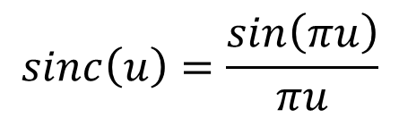
$$sinc\left(u\right)=\frac{sin\left(πu\right)}{πu}$$

Slide 3
Time domain | Frequency domain
Sine wave | Impulse
Rectangle | Sinc
Convolution | Multiplication

Slide 5
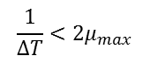
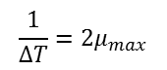
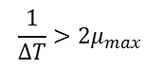
No sampling
Oversampled
$$\frac{1}{∆T}>2μ_{max}$$
Critically sampled
$$\frac{1}{∆T}=2μ_{max}$$
Undersampled
$$\frac{1}{∆T}<2μ_{max}$$

Slide 7
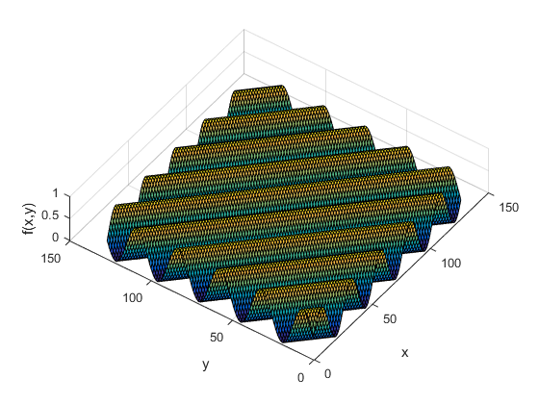
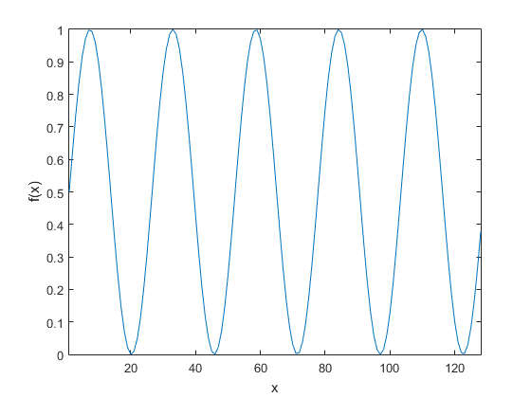
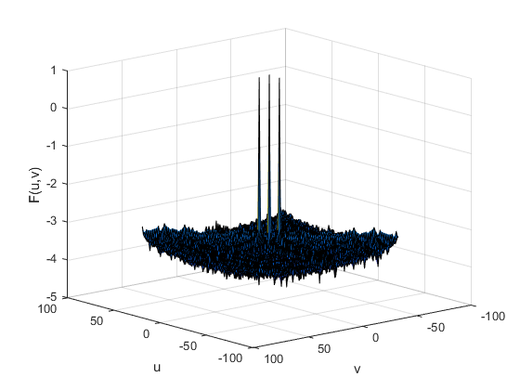
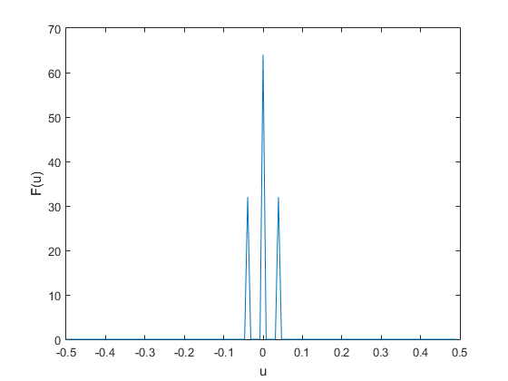
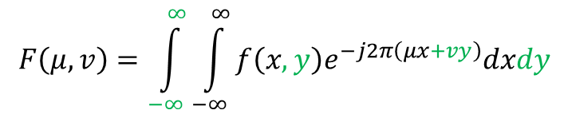
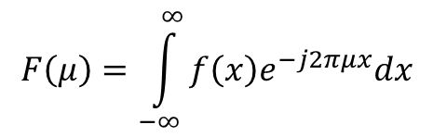
1D → 2D : Continuous Fourier Transform
$$F\left(μ\right)=\int_{−∞}^{∞}{f\left(x\right)e^{−j2πμx}dx}$$
$$F\left(μ,v\right)=\int_{−∞}^{∞}{\int_{−∞}^{∞}{f\left(x,y\right)e^{−j2π\left(μx+vy\right)}dxdy}}$$

Slide 8
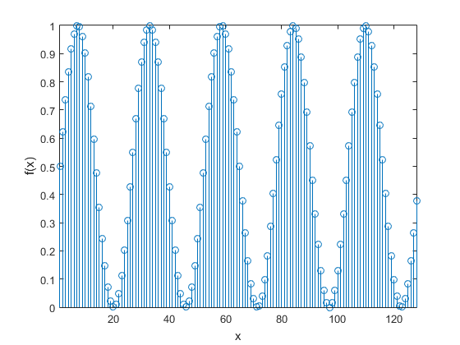
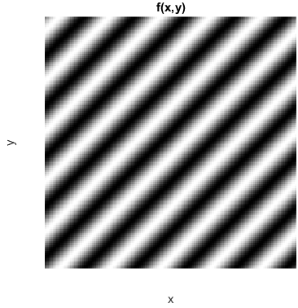
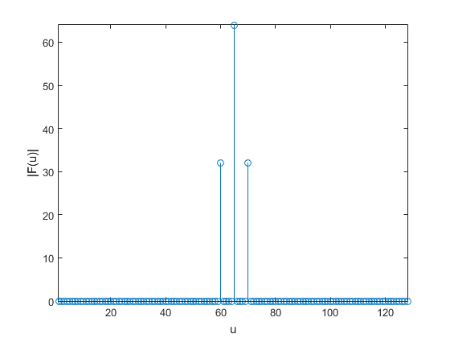
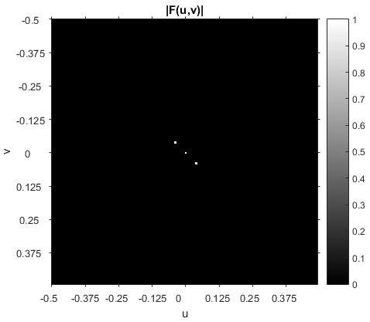
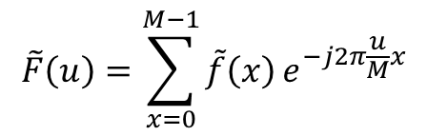
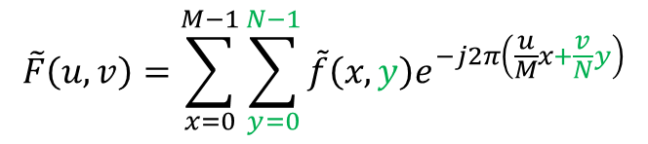
1D → 2D : Discrete Fourier Transform
$$\tilde{F}\left(u\right)=\sum_{x=0}^{M−1}{\tilde{f}\left(x\right)}e^{−j2π\frac{u}{M}x}$$
$$\tilde{F}\left(u,v\right)=\sum_{x=0}^{M−1}{\sum_{y=0}^{N−1}{\tilde{f}\left(x,y\right)e^{−j2π\left(\frac{u}{M}x+\frac{v}{N}y\right)}}}$$

Slide 9
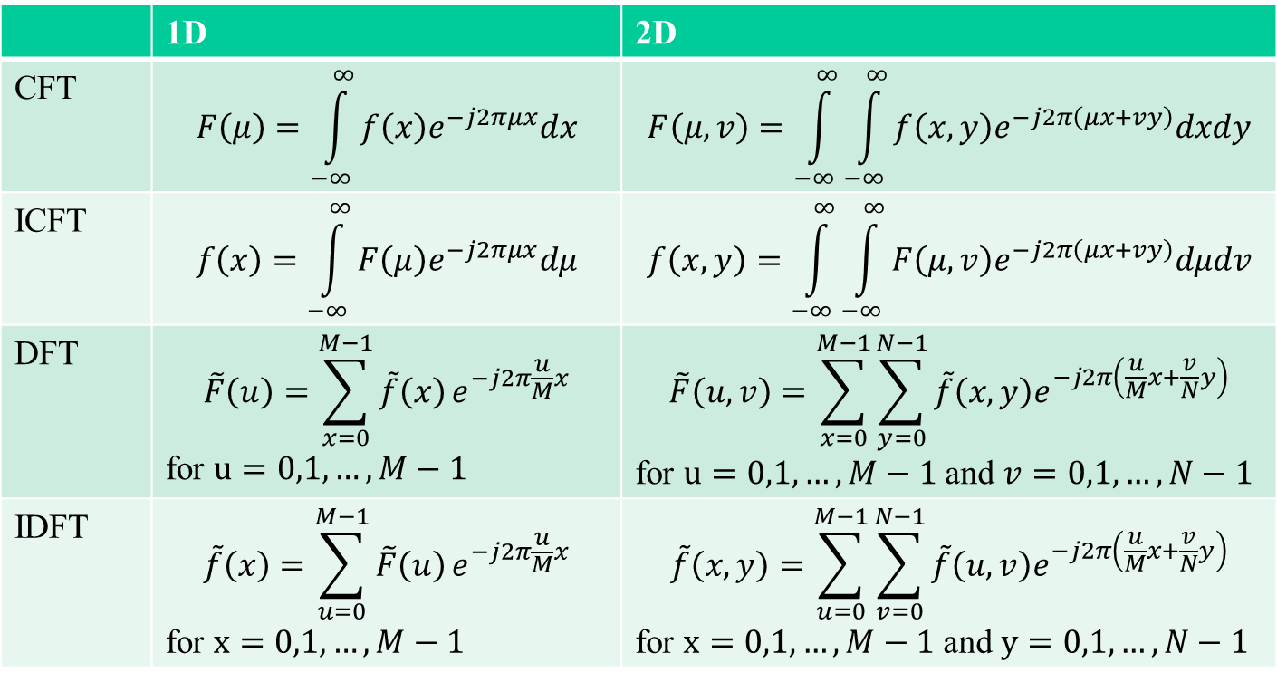
 | 1D | 2D
CFT | $$F\left(μ\right)=\int_{−∞}^{∞}{f\left(x\right)e^{−j2πμx}dx}$$ | $$F\left(μ,v\right)=\int_{−∞}^{∞}{\int_{−∞}^{∞}{f\left(x,y\right)e^{−j2π\left(μx+vy\right)}dxdy}}$$
ICFT | $$f\left(x\right)=\int_{−∞}^{∞}{F\left(μ\right)e^{−j2πμx}dμ}$$ | $$f\left(x,y\right)=\int_{−∞}^{∞}{\int_{−∞}^{∞}{F\left(μ,v\right)e^{−j2π\left(μx+vy\right)}dμdv}}$$
DFT | $$\tilde{F}\left(u\right)=\sum_{x=0}^{M−1}{\tilde{f}\left(x\right)}e^{−j2π\frac{u}{M}x}$$ for $u=0,1, …, M−1$ | $$\tilde{F}\left(u,v\right)=\sum_{x=0}^{M−1}{\sum_{y=0}^{N−1}{\tilde{f}\left(x,y\right)e^{−j2π\left(\frac{u}{M}x+\frac{v}{N}y\right)}}}$$ for $u=0,1, …, M−1$ and $v=0,1, …, N−1$
IDFT | $$\tilde{f}\left(x\right)=\sum_{u=0}^{M−1}{\tilde{F}\left(u\right)}e^{−j2π\frac{u}{M}x}$$ for $x=0,1, …, M−1$ | $$\tilde{f}\left(x,y\right)=\sum_{u=0}^{M−1}{\sum_{v=0}^{N−1}{\tilde{f}\left(u,v\right)e^{−j2π\left(\frac{u}{M}x+\frac{v}{N}y\right)}}}$$ for $x=0,1, …, M−1$ and $y=0,1, …, N−1$

Slide 10
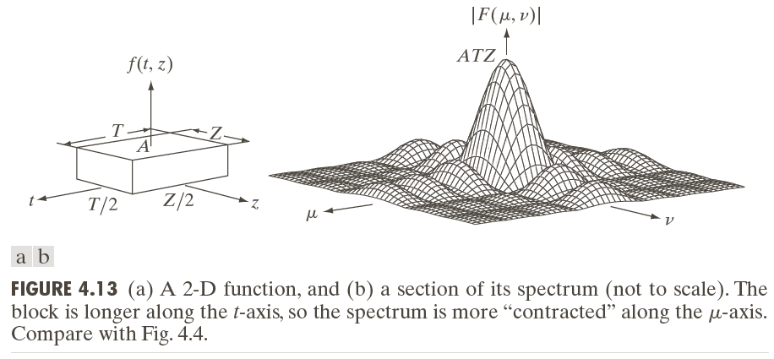
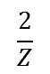
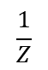
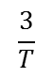
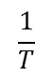
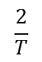
 | f(...) | F(...)
1D | Rectangle | Sinc
2D | Box | ”2D-sinc”
$$\frac{1}{Z}$$
$$\frac{2}{Z}$$
$$\frac{3}{T}$$
$$\frac{2}{T}$$
$$\frac{1}{T}$$

Slide 11
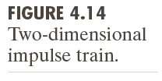
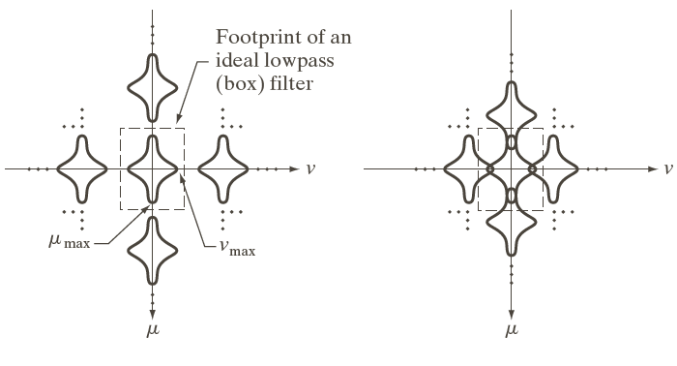
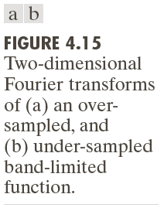
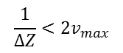
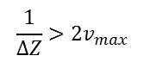
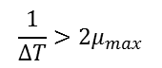
Oversampled
Undersampled
$$\frac{1}{∆T}>2μ_{max}$$
$$\frac{1}{∆Z}>2v_{max}$$
$$\frac{1}{∆T}<2μ_{max}$$
$$\frac{1}{∆Z}<2v_{max}$$

Slide 13
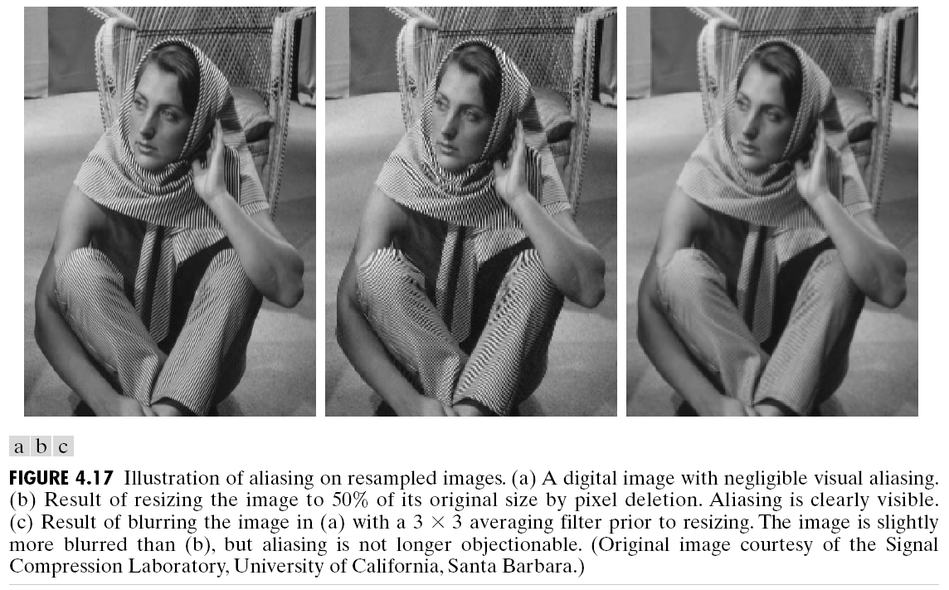

Slide 17
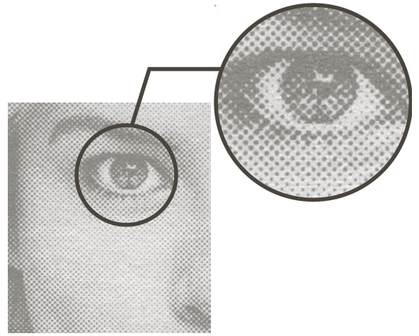
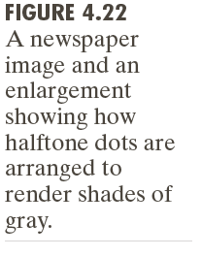

Slide 20
DEMO: imFaseIsImportant.m

Slide 21
Lab 3

